Slide 1
Wavelength-Division Multiplexing
Prepared By: Er. Amit KrTewari
Associate Professor
CS Dept.
ACEIT, Jaipur

Slide 2
Wavelength-Division Multiplexing
Wavelength-division multiplexing, another name for frequency-division multiplexing, has been widely used in radio, TV, and telephone systems.
The best example today is the multiplexing of dozens of TV signals on a common coaxial cable coming into the home.

Slide 3
Wavelength-Division Multiplexing
In WDM, different frequencies or “colors’’ of infrared light are employed to carry individual data streams. These are combined and carried on a single fiber.
Although frequency as a parameter is more widely used to distinguish the location of wireless signals below 300 GHz, at light frequencies the wavelength parameter is the preferred measure.

Slide 4
Coarse Wavelength-Division Multiplexing
The first coarse WDM (CWDM) systems used two channels operating on 1310 and 1550 nm. Later, four channels of data were multiplexed.
The data source may be a single data source or a multiple TDM source. Current systems use light in the 1550-nm range.
A typical four channel system uses laser wavelengths of 1534, 1543, 1550, and 1557.4 nm.
The laser beams are then optically combined and transmitted over a single-fiber cable.
At the receiving end of the cable, special optical filters are used to separate the light beams into individual channels. Each light beam is detected with an optical sensor and then filtered into the four data streams.

Slide 5
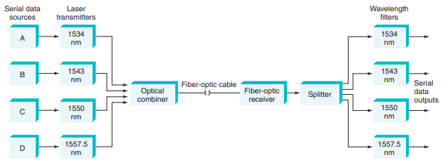
CWDM Fiber-Optic System

Slide 6
Dense Wavelength-Division Multiplexing
Dense wavelength-division multiplexing (DWDM) refers to the use of 8, 16, 32, 64, or more data channels on a single fiber.
Standard channel wavelengths have been defined by the International Telecommunications Union (ITU) as between 1525 and 1565 nm with a 100-GHz (approximately 0.8-nm) channel spacing.
The block of channels between about 1525 and 1565 nm is called the C or conventional band.
Most DWDM activity currently occurs in the C band. Another block of wavelengths from 1570 to 1610 nm is referred to as the long-wavelength band, or L band.
Wavelengths in the 1525- to 1538-nm range make up the S band.

Slide 7
Dense Wavelength-Division Multiplexing
Current DWDM systems allow more than 160 individual data channels to be carried simultaneously on a single fiber at data rates up to 40 Gbps, giving an overall capacity of 160 3 40, or 6400, Gbps (6.4 Tbps).

Slide 8
Arrayed Waveguide Grating (AWG)
Numerous methods have been developed over the years to add and separate optical signals.
Optical couplers can be used for multiplexing, and optical filters such as fiber Bragg gratings or thin films can be implemented for demultiplexing.
But the one method that appears to be emerging as the most popular is the arrayed waveguide grating (AWG).
This device is an array of optical waveguides of different lengths made with silica (SiO2) on a silicon chip, and it can be used for both multiplexing and demultiplexing.

Slide 9
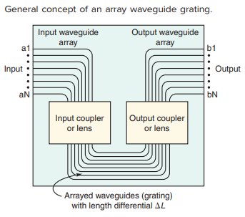
Arrayed Waveguide Grating (AWG)

